Slide 1
CSE 486/586 Distributed Systems Byzantine Fault Tolerance --- 2
Steve Ko
Computer Sciences and Engineering
University at Buffalo

Slide 2
Recap
Fault categories
Benign
Byzantine
Consensus results
Paxos: f faulty nodes → 2f + 1 total nodes
BFT: f faulty nodes → 3f + 1 total nodes
Byzantine generals problem
A commanding general & N - 1 lieutenant generals
All loyal lieutenants obey the same order.
If the commanding general is loyal, then every loyal lieutenant obeys the order the commanding general sends.

Slide 3
Intuition for the Result
Question: how many votes do I need?
In Paxos, I need f + 1 votes out of 2f + 1 nodes, since that’s the majority.
Let’s apply this to the Byzantine generals problem.
Let’s say we obtain f + 1 votes.
Up to f nodes can lie → f + 1 votes cannot give a consensus
We need more votes from the honest nodes than the faulty nodes.
If we obtain 2f + 1 votes, then we have at least f + 1 honest nodes, one more than the number of faulty nodes.
But, f nodes still might just simply fail, not reply at all.
In order to get 2f + 1 votes under the possibility of f no replies,
We need at least 3f + 1 nodes in total.

Slide 4
Intuition for the Result
Liveness
The total # of nodes we need: quorum size + f
Because f might not reply at all

Slide 5
Intuition for the Result
Safety
The quorum size we need: more honest nodes than the Byzantine nodes → 2f + 1 with f faulty nodes
Quorums have at least 2f + 1 replicas
Quorum A
Quorum B
Quorums intersect in at least one correct replica

Slide 6
Practical Byzantine Fault Tolerance
Byzantine fault tolerance (BFT) protocols thought to be too expensive and impractical.
PBFT (Practical BFT) was then proposed, which showed a rather inexpensive & practical BFT protocol.
With asynchrony & f Byzantine nodes
This resurrected the interest in BFT protocols.

Slide 7
State Machine Replication
Byzantine generals problem
A commanding general
Lieutenant generals
Primary-backup replication
State machine replication: everyone should execute instructions in the same order
Primary: the commanding general
Backups: the lieutenant generals

Slide 8


Primary-Backup Challenges
The same order (sequence number) of requests
Handling primary failures
Client
Client
Request A
Request B

Slide 9
CSE 486/586 Administrivia
Project 3 out
Please, please start right away!
Deadline: 4/30 (Monday) @ 11:59PM
Final
5/7 (Monday), 3:30PM - 6:30PM
Norton 112

Slide 10
System Setting
Each replica has an id i (between 0 and N-1)
A view number v identifies the current primary.
Current primary: i = v mod N
If the current primary fails, the next primary is i + 1 mode N
Each client request has a sequence number
All messages are authenticated using crypto-based techniques.
Anyone can verify who sent the message & if the message content is correct.
(Using public-key signatures, message authentication codes, and message digests) (topics for next lecture)
Forgery is practically not possible.

Slide 11
Client Protocol
A client sends each request to the primary.
All replicas reply directly to the client.
The client waits until it receives f + 1 replies with the same result.
The client accepts the result.
If the client doesn’t receive replies soon enough, it multicasts the request to all replicas.

Slide 12
Primary-Backup Protocol
Normal case operation
View changes
Garbage collection
State transfer
Recovery
All have to be designed to work together

Slide 13
Normal Case Operation
Three phases
PRE-PREPARE picks order of requests
PREPARE ensures order within views
COMMIT ensures order across views
Replicas remember messages in log
Messages are authenticated
{.}_{σk} denotes a message sent by k

Slide 14
Pre-Prepare Phase
The primary picks a sequence number n.
Request: m
{PRE-PREPARE, v, n, m}_{σ0}
Primary: Replica 0
Replica 1
Replica 2
Fail
Replica 3

Slide 15
Prepare Phase
Request: m
PRE-PREPARE
Primary: Replica 0
Replica 1
Replica 2
Fail
Replica 3
Accepted PRE-PREPARE

Slide 16
Prepare Phase
Request: m
PRE-PREPARE
Primary: Replica 0
{PREPARE, v, n, D(m), 1}_{σ1}
Replica 1
Replica 2
Fail
Replica 3
Accepted PRE-PREPARE

Slide 17
Prepare Phase
Request: m
Collect PRE-PREPARE + 2f matching PREPARE
PRE-PREPARE
Primary: Replica 0
{PREPARE, v, n, D(m), 1}_{σ1}
Replica 1
Replica 2
Fail
Replica 3
Accepted PRE-PREPARE

Slide 18
Commit Phase
Request: m
PRE-PREPARE
PREPARE
Primary: Replica 0
Replica 1
{COMMIT, v, n, D(m)}_{σ2}
Replica 2
Fail
Replica 3

Slide 19
Commit Phase
Request: m
Collect 2f+1 matching COMMIT: execute and reply
PRE-PREPARE
PREPARE
COMMIT
Primary: Replica 0
Replica 1
Replica 2
Fail
Replica 3

Slide 20
View Change
Provide liveness when primary fails
Timeouts trigger view changes
Select new primary (= v mod N)
Brief protocol
Replicas send VIEW-CHANGE message along with the requests they prepared so far
New primary collects 2f+1 VIEW-CHANGE messages
Constructs information about committed requests in previous views

Slide 21
View Change Safety
Goal: No two different committed request with same sequence number across views
Quorum of Committed Replicas
View Change Quorum
At least one correct replica overlaps

Slide 22
More Issues
…that we don’t discuss.
Garbage collection
Recovery
State transfer
Optimizations

Slide 23
Performance
Andrew benchmark
Andrew100 and Andrew500
4 machines: 600 MHz, Pentium III
3 Systems
BFS: based on BFT
NO-REP: BFS without replication
NFS: NFS-V2 implementation in Linux
Normal-case performance

Slide 24
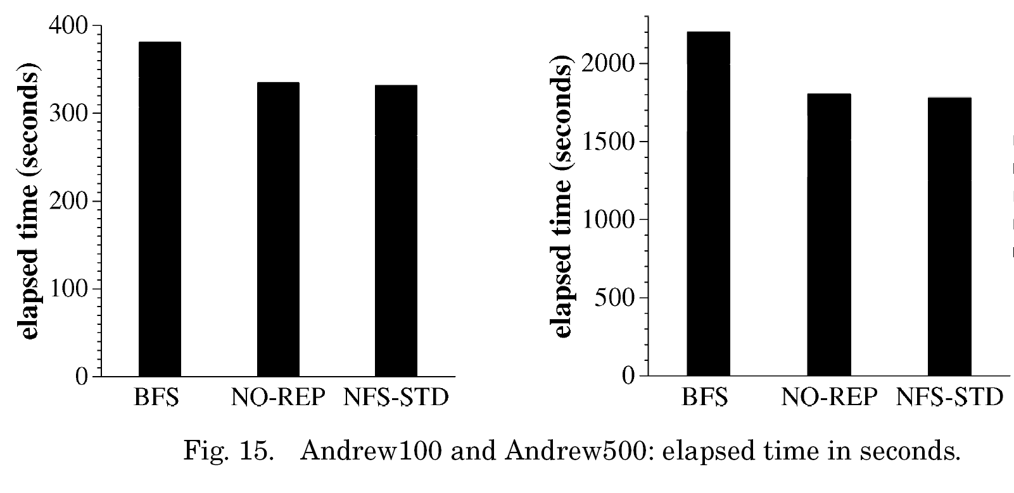
Benchmark Results

Slide 25
Summary
Practical Byzantine Fault Tolerance
Rather practical BFT
Three phases
Pre-prepare
Prepare
Commit
View change
When the primary fails, the next id becomes the new primary

Slide 26
Acknowledgements
These slides contain material developed and copyrighted by Indranil Gupta (UIUC).

